Slide 1
Page 0
First Letter of your last name: D
Your Full Name: Wyatt Duberstein
I promise I do not cheat on the exam. Your initial: WD
COM S 363: Exam 2
NOTES:
This is an open book open note exam.
You must work by yourself, without discussing with anyone else except TAs or instructors.
You can handwrite, but you are strongly encouraged to type/draw on these slides directly. Some shapes may be given for your convenience. If you do handwrite, write legibly; if the grader can't read, at their sole discretion, you receive no point.
Answer concisely and precisely. One effective way to lose points is to write nonsenses. HINT: The spaces you are given are more than you need.
Submit your file in PDF format.
Problem | Max Points | Points
1 | 15
2 | 25
3 | 20
4 | 15
5 | 25
Total | 100

Slide 2
Page 1
1. (15 points) Suppose a relation is stored in heap files showing below. The slots with “empty” are free space.
(4 points) From the illustration, can you decide if the records are fix length or variable length, packed or unpacked?
Fixed Length, Unpacked
(2) (6 points) Suppose a user inserts another record. What the result files should look like?
It will scan through header pages sequentially and find that there is an open space in header page 1, in which it will select the open space and the record will be inserted there.
(3) (5 points) Suppose a user wants to delete a record. This record is located at the highlighted red slot. What is the procedure?
It will scan the tables and find the corresponding data entry, then remove it by turning the corresponding bit in the bit map to 0.
empty
0 | 1 | 1 | 1 | 1 | 1 | 6
Header
Page
 | 1
 | 2
 | 3
empty
empty
1 | 0 | 1 | 1 | 0 | 1 | 6
empty
empty
empty
1 | 0 | 0 | 1 | 0 | 1 | 6

Slide 3
Page 2
(25 points) Consider a relation with this schema, Employee(ename:string, eid:integer, age:integer, salary:integer). Suppose ename is indexed by a sparse B⁺-tree (primary) and eid is indexed by a dense and unclustered B⁺-tree (secondary), as roughly illustrated by the figure showed in the next page. Suppose the relation has 1,000 pages, and each page is 512 bytes and can hold 16 records. Size of primary search key is 23 bytes, size of secondary search key is 2 bytes, and the size of a pointer is 2 byte.
  (5 points) Calculate the number of pages for data entry nodes in the secondary B⁺-tree.
The SearchKeySize for the secondary tree is 2 bytes, the PointerSize is 2 bytes, and the PageSize is 512 bytes. Therefore, we have (2*n) + (2*(n+1)) = 512, therefore n = 128. With 1000 total pages, that means we need 1000 / 128 = 8 pages, + 1 for the directory node so 9 Pages.
Estimate the total number of pages that need to be read from the disk in order to answer the following queries. Explain your answer. For each query, you can assume the selection factor is 0.1, i.e., out of 1,000 * 16 records, 1,000 * 16 * 0.1 = 1600 records will satisfy each query condition.
  b) (5 points) Find all employees whose ages are in between 40 and 50.
  Since the entire file is being scanned due to it being a ranged selection, it’s 1600 records / 16 records per page = 100, then it’s 100 pages * D for cost.
  c) (7 points) Find all employees whose name starts with a character that is in between “C” and “F”.
  For C and D: The SearchKeySize for the secondary tree is 2 bytes, the PointerSize is 2 bytes, and the PageSize is 512 bytes. Therefore, we have (2*n) + (23*(n+1)) = 512, therefore n = 20. With 1000 total pages, that means we need 1000 / 20 = 50 pages, + 1 for the directory node so 51 Pages.
  D * log(20) + 51 = 52 * D Pages
  d) (8 points) Find all employees whose eid is in between 100 to 200.
  Taking the values from Part A, we have D * log(128) + 9 pages = 11 * D Pages

Slide 4
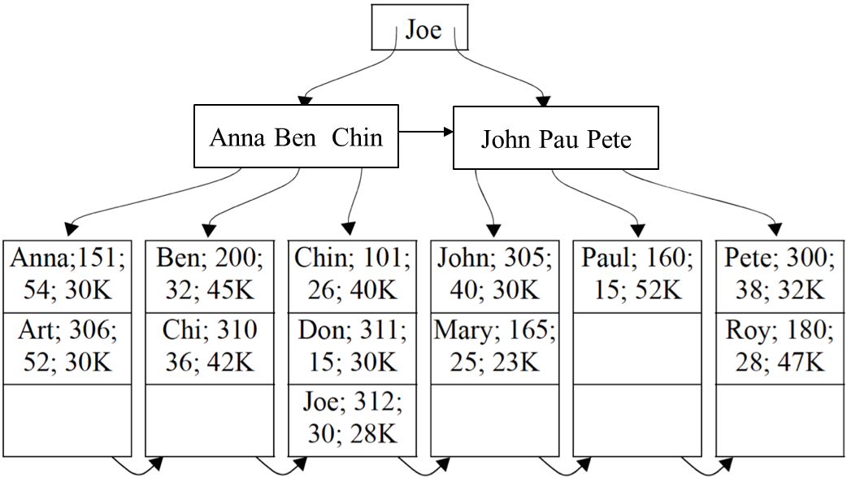
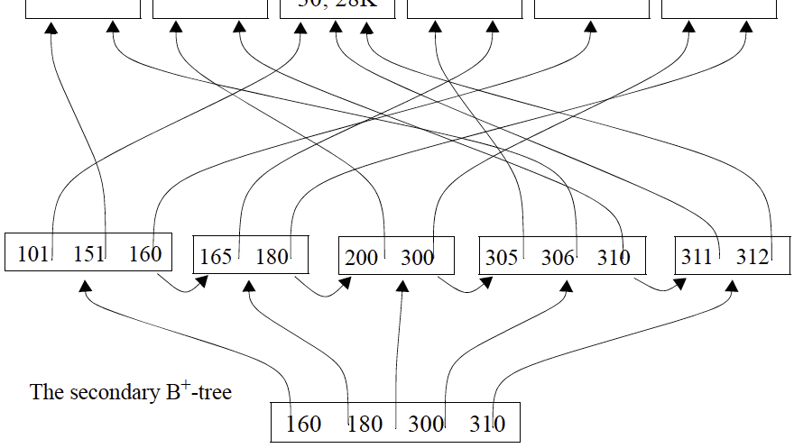
Page 3
The primary B⁺-tree

Slide 5
Page 4
(20 points) Explain how to sort 120 pages of data (e.g., numbers) with 4 pages of main memory in detail (i.e., pass 1, pass 2, ..., until the data is sorted) and estimate the I/O cost. Your algorithm needs to minimize disk I/Os (i.e., the number of pages that need to be read from and written to the disk). When sorting in main memory, you can assume you have the additional memory for swapping two numbers.
Starting off, we would need to make 30 passes through the data. Each pass would fill the available main memory with blocks from the original relation to be sorted. Then it would sort the records in main memory using built-in memory sorting techniques in main. It would then take the sorted records and write them from the first block to new blocks of secondary memory. This creates a new sorted list. After creating several sorted lists, it would then merge all the sorted lists into a single sorted master list of all the records. The estimated I/O cost of this operation would be 480 pages.

Slide 6
Page 5
(15 points) Suppose we have relation R of 120 pages in size, and relation S of size 40 pages, not sorted. We want to join RF and S based on their primary keys. The size of main memory is 10 pages. Suppose the hash functions we choose uniformly partition the relation, fudge factor f=1.
  (6 points) After the partition phase, (numeric answers)
  R is divided into 9 partitions, each of which is about 13 pages;
  S is divided into 4 partitions, each of which is about 10 pages.
  (3 points) In the probing phase, which relation should be further partitioned using the B-2 memory pages?
    R
    S
    Both R and S
    Either R or S
    Neither R nor S
your answer: R (i)
  (3 points) Suppose the memory size is 5 pages instead of 10 pages. Is this change going to affect the I/O cost of Grace Hash Join? Choose your answer and explain why.
    Yes, I/O cost is going to increase
    Yes, I/O cost is going to decrease
    No, I/O cost is going to remain the same
    It may or may not affect the I/O cost.
  your answer: Yes, increase (i)
  explanation: It would have to partition the data more as there would be less memory to on disc to hold all of that data
  (3 points) Suppose the memory size is 15 pages instead of 10 pages. Is this change going to affect the I/O cost of Grace Hash Join? Choose your answer and explain why.
    Yes, I/O cost is going to increase
    Yes, I/O cost is going to decrease
    No, I/O cost is going to remain the same
    It may or may not affect the I/O cost.
  your answer: Yes, decrease (ii)
  explanation: It would have less data to partition, thus less overall partitioning and probing

Slide 7
Page 6
(25 points) Derive the I/O costs of different join algorithms of relations R and S given the following variables, which you may or may not use all of them. Ignore the CPU time costs and the cost of writing the results. Write down steps for partial credits
  |R|=10: Number of tuples in R
  |S|=20: Number of tuples in S
  M=120: Number of pages in R
  N=40: Number of pages in S
  B=10: Number of available memory in pages
(5 points) What is the minimal I/O cost of block nested loop join?
Formula: M + (M /(B – 2)) * N
R: 120 + (120 / (10 – 2)) * 40 = 720
S: 40+(40 / (10 – 2)) * 120 = 640
Therefore, S should be the outer relation for minimal cost of 640.
(5 points) What is the minimal I/O cost of simple nested loop join?
Formula: M+M*|R|*N
R: 120 + 120 * 10 * 40 = 48,120
S: 40 + 40 * 20 * 120 = 96,040
Therefore, R should be the outer relation for the minimal cost of 48,120
(5 points) What is the minimal I/O cost of indexed nested Loops Join​? (suppose the cost of retrieving a matching tuple is 2, for both R and S)
Formula: M+M*|R|*(Cost of retrieving a matched tuple in each)
R: 120 + 120 * 10 * 2 = 2,520
S: 40 + 40 * 20 * 2 = 1,640
Therefore, S should be the outer relation for the minimal cost of 1,640
(5 points) What is the minimal I/O cost of grace hash join?
Formula: 3*(M+N)
Therefore: 3 * (120 + 40) = 480
Since the result for this formula is the same for each relation, the minimal cost is 480.
(5 points) What is the minimal I/O cost of Sort-Merge Join​? (suppose the join is on their primary keys which are sorted already)
R: log(120) * 120 * 2 = 499 pages
S: log(40) * 40 * 2 = 128 pages
499 + 128 + 160 = 787

